Slide 1
Fuad Hasan
GEOG 4057
Final project 1
Report

Slide 2
Steps I followed for converting the json file to shapefile
Explore json file
Create feature class and write table
Add data to feature class
Creating python toolbox

Slide 3
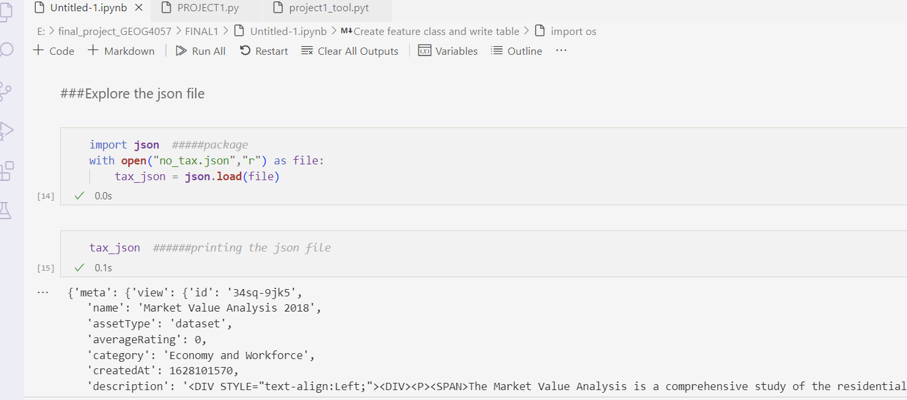
Part 1: Step 1 to 3; Exploring the json file
Full code is attached in the file

Slide 4
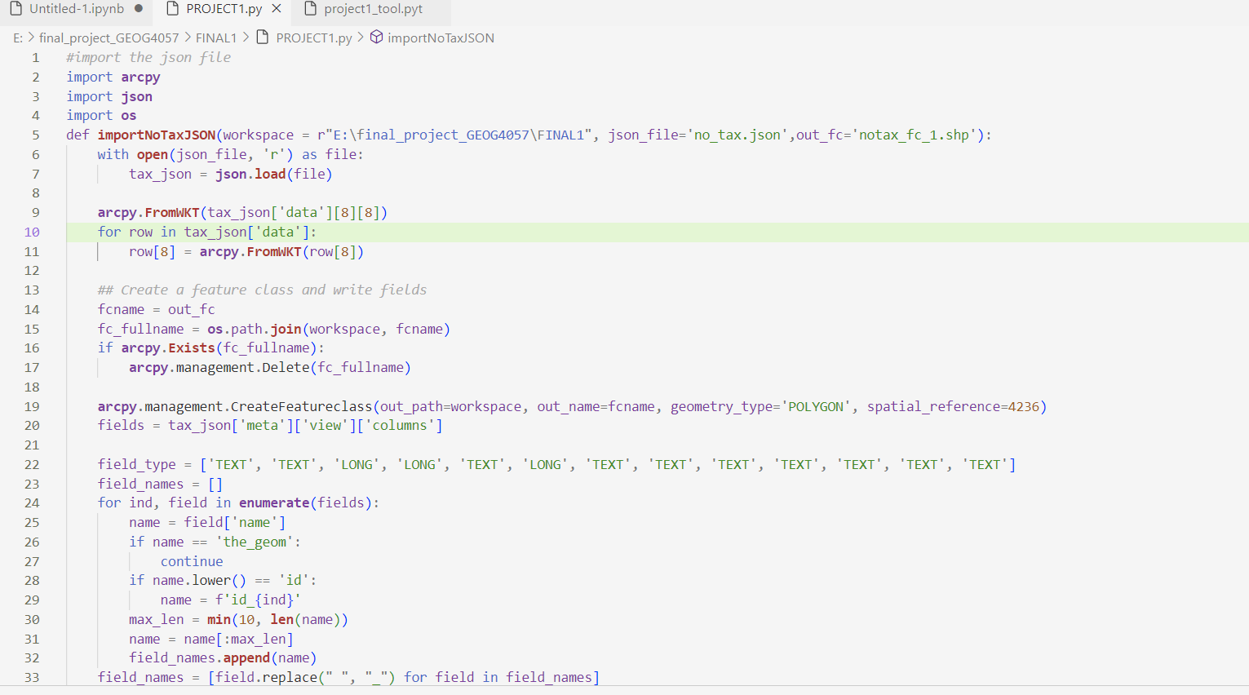
Code to work with JSON file and pyt file in next step
Full code is attached in the file

Slide 5
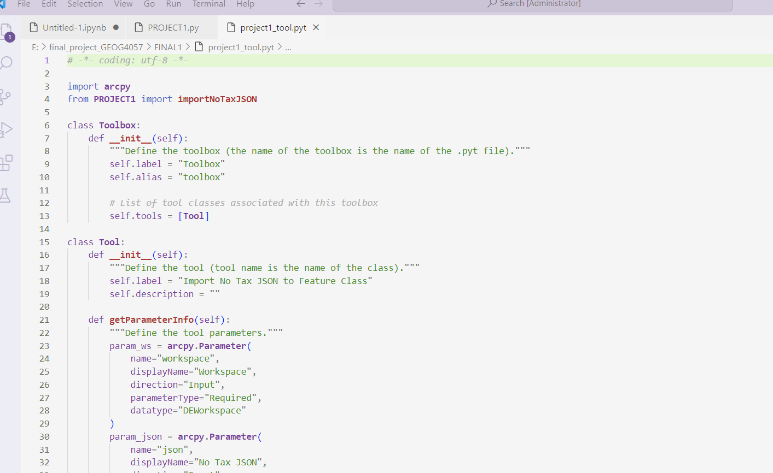
pyt toolbox code
Full code is attached in the file

Slide 6
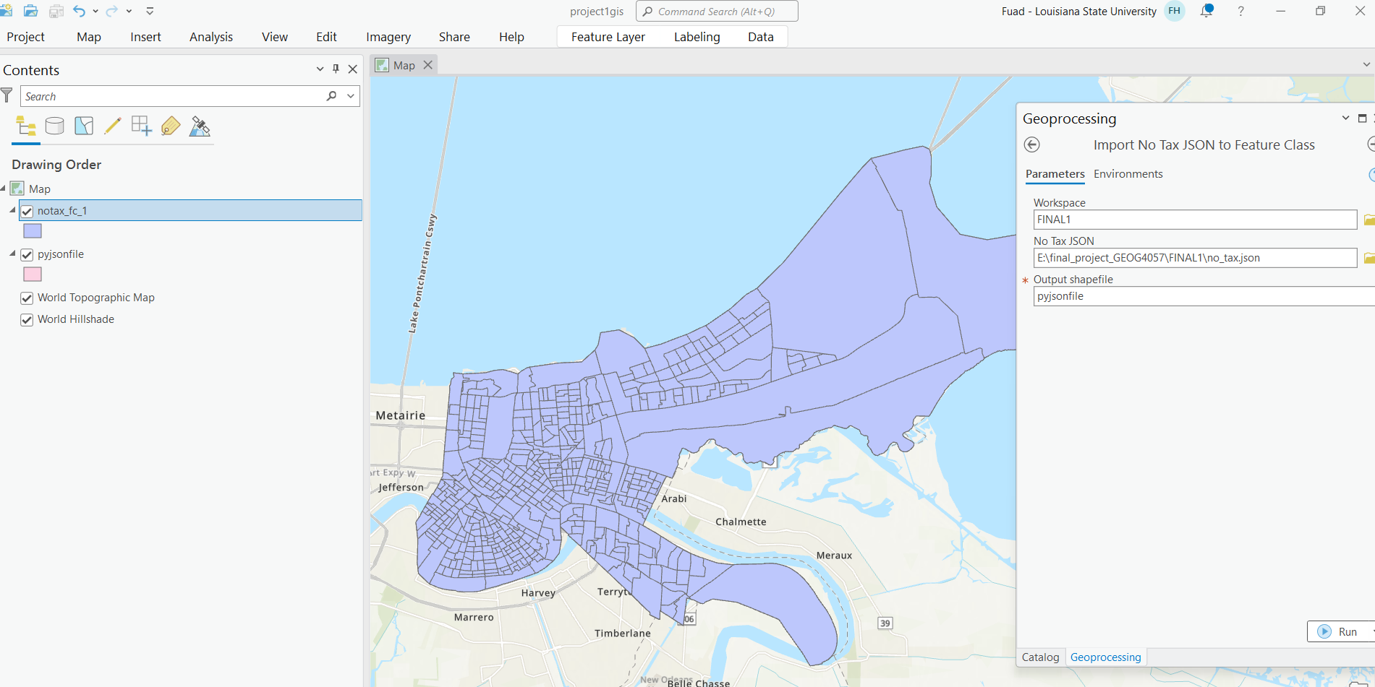
Setting up the toolbox in ArcGIS Pro, and the output is here
Using Code
Using python toolbox

Slide 7
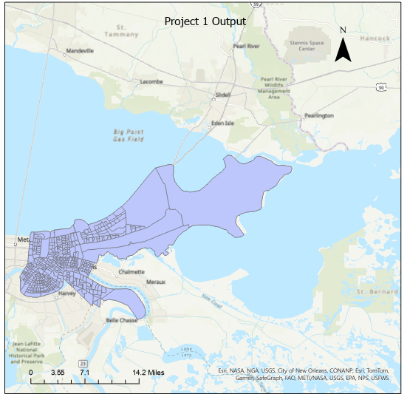
Final Map

